Slide 1
CALLed to be an
INtentional Advisory
Council
Serving Christ in Love
Notes:
Prayer
Devotion

Slide 2
Welcome
Name
Hometown
Advisory Council
Position

Slide 3
Did you know?
$6 million budget
Overseen by 12 paid people
Serving in over 500 communities
In 37 states
In 9 foreign countries
Over 30,000 volunteers
Provide estimated 3,000,000 hours of service annually
  Valued at $36 M
Notes:
When you said yes to serving in Kairos Prison Ministry International, you became part of something so much bigger than your Advisory Council, bigger than your state. Part of changing one heart, changing communities, impacting the world!

Slide 4



One Ministry
One set of Advisory Council Operating Procedures
One Mission
One Vision
One Message, Listen Listen Love Love
Notes:
Each of us serve as part of the Body of Christ in this Kairos Prison Ministry International under the Advisory Council Operating Procedures. In 3 settings, with 3 audiences. But with the SAME…..

Slide 5
Kairos Mission Statement
The mission of Kairos Prison Ministry is to share the transforming love and forgiveness of Jesus Christ to impact the hearts and lives of incarcerated men, women, and youth, as well as their families, to become loving and productive citizens of their communities.

Slide 6
Vision Statement
A community spiritually freed from the effects of imprisonment reaching all impacted by incarceration through the love, hope, and faith found in Jesus Christ

Slide 7

Core Values
Lay led, Christ centered ministry
Empowerment while building accountability
Continuing ministry model to build community
Trustworthy
Respect and love
Stewardship

Slide 8
Kairos Statement of Faith
The people of Kairos are called by God to share the love of Christ with those impacted by incarceration. Kairos encourages believers from a variety of Christian traditions to be volunteers in this Christ-filled ministry.
Kairos programs offer to prison residents, their families, and those who work with them the opportunity to receive God’s forgiveness through faith in Jesus Christ, and to grow in their faith and servant-hood in Christian community.
We stand on the common ground of the following elements of Faith:
We in Kairos believe:
  The Bible is God’s authoritative and inspired word for our faith and our lives.
  In the Trinity of the Father, Son and Holy Spirit.
  In the deity, death and resurrection of Jesus Christ.
  Friendship with God is a free gift, for God so loved the world that He gave his one and only son so that whoever believes in Him shall not perish but have eternal life.
  The Love of Jesus Christ motivates His followers to provide food for the hungry, drink to the thirsty, welcome to the stranger, clothes for the naked and visits to the sick and those in prison.
  In sharing the love and forgiveness of Jesus Christ with all incarcerated individuals, their families and to those who work with them inside and outside the correctional institution
Notes:
It is important to make sure that our volunteers understand that these foundational documents are the essence of Kairos Prison International and need to be reviewed in first team meeting.

Slide 9
What is YOUR Why?
Notes:
It is our goal to present information that is helpful to you. We are setting up a parking lot for questions. If at the end we have not covered your questions we will strive to leave time at the end to answer them and have some discussion and networking time. We also want to acknowledge that each state and sometimes each institution have unique requirements and challenges. We are taking some time now to find out : Why did you choose this workshop? Make a list refer to later. (compare to our list?)

Slide 10
What is an Advisory Council?
Members working together to ensure the success of the ministry
Why is it Important?
Boots on the ground
Healthy Advisory Council
=
Healthy Ministry
Notes:
We work together striving to use our gifts and calling effectively while fulfilling the responsibilities of the Advisory Council. You are the first line of oversight within the Kairos International Ministry. Your service in this role is vital and comes with joys and opportunities for growth. What you do insures a Kairos presence in your institution.

Slide 11
Members
14 voting positions
Other nonvoting positions
Work intentionally
Motivate and encourage volunteers to share in the success of the ministry
Notes:
Make up of an Advisory Council and roles are detailed in the Advisory Council Operating Procedures. Working with a plan. The better we do our jobs on Advisory Councils the smoother our Continuing Ministry and weekends will run. We want to be continually growing and informing our volunteers to work alongside the council especially in the areas of fundraising, recruiting and outreach. The support of the community eases the pressure on the Advisory Council while growing the ministry. Including community volunteers requires a plan.

Slide 12
Purpose and Role
Manage ALL aspects of the local Kairos community
Serve in only one Advisory Council
Advisory Councils serve only one institution

Slide 13
Spiritual Health of the Ministry
While we are busy doing the business of Kairos we must remember whose we are and who we serve.
Each of you should use whatever gift you have received to serve others, as faithful stewards of God’s grace in its various forms. If anyone speaks, they should do so as one who speaks the very words of God. If anyone serves, they should do so with the strength God provides, so that in all things God may be praised through Jesus Christ. To him be the glory and the power for ever and ever. Amen. 1 Peter 4:10, 11
Notes:
Sometimes we get so focused on the lists that need to be accomplished we forget the vital role relationships play in leading levels of the ministry.

Slide 14

Building the Body of Christ
A Call to relationships
With Jesus
In the institutions
Within our Advisory Councils
With our volunteers
State Chapter committees
Notes:
Everything we do comes back to building good relationships.
Starting with our own relationship with God and outward to those we serve and volunteer with.

Slide 15
Relationships in the Institution
Chaplain
Institutional Liaison and Chair build a cooperative and supportive relationship
Provide Kairos materials pointing out Kairos commitment to respect and mutual
Notes:
Chaplain acts as our go between. Some need reassurance of our mission to come along side and empower not replace or challenge. Be aware of balancing ministry in an institutional setting. Are there ways to be encouraging? Program manuals spell out our commitment of respecting that we are guests in the Warden’s house. Handing them our 346 page manual is a bit overwhelming, give specific references, communicate.

Slide 16
Relationships in the Institution
Institution Administration
Insure the institutional liaison is following through with communication and prison policies, acting as an effective go between
Maintain a MOU- Memorandum of Understanding
Listen and address any issues or concerns
Notes:
Administration = warden, security or designee. Institutional Liaison is pivotal in building a good working relationship. Listening in Love is the greatest tool, hear with grace. Remember there are burdens we may be unaware of, security threats, understaffing…. Sometimes complaints just need acknowledgement of frustration/ understanding. How can we come alongside? If only in praying for eyes to see the value Kairos brings to the community.

Slide 17
Relationships in the Institution in Continuing Ministry
Prayer and Share/ SWAP share, witness, accountability and pray
Provide tools and knowledge empowering residents to build their community
Prayer and Share / Share Witness Accountability and Pray
Mentoring in Torch
Retreats
Reunions
Freedom Guides
Relationships
Notes:
Continuing Ministry the heart of our goal. Prayer and support. Mentoring in Torch is critical.
We operate continuing ministry within the requirements of each institution. Kairos Prison Ministry International has best practices as a goal.

Slide 18
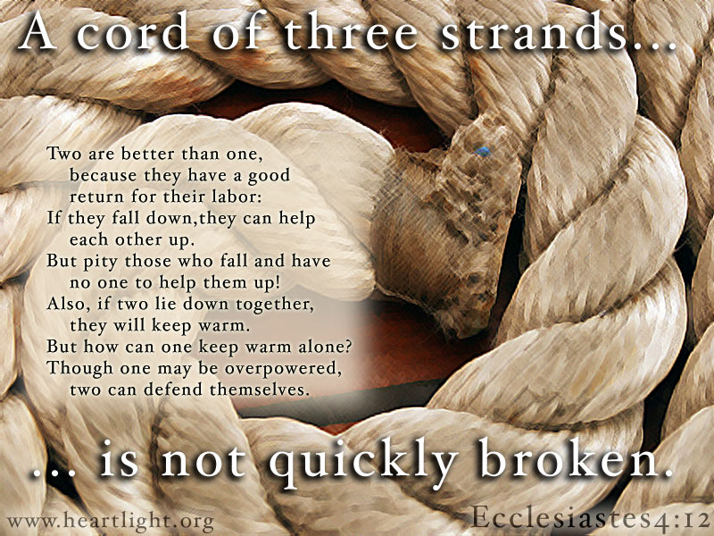
Relationship with Volunteers
In the Advisory Council
Remain Spiritually grounded while doing the work of Kairos
Listen Listen Love Love each other
Be supportive and accountable to each other
Face difficulties and differences with grace
Notes:
Remember why we answered the call and maintain awareness that Jesus is our example.
How often do 14 people all have the same solutions for an issue?
Each have been created to serve uniquely. Appreciate our differences they make the body strong and creatively capable.
Extend the same grace to each other as we do to those we go out and serve.
Relationships allow us to be there for each other, encouraging and motivating growth as opposed to criticism or judgement. We all have times that we need someone to come along side.
When there are situations that call for resolution Matthew 18 is your starting point. Many can be solved with a reminder of our commitment, referral to the Program manuals, the 4 foundational documents and the Kairos Code of conduct. There are clear processes provided for disciplinary solutions in the Program Manual, Advisory Council Operating Procedures, Kairos Code of Conduct

Slide 19
Relationships with Volunteers
Weekend Leaders
Share Advisory Council’s goals and needs
Support in strategically choosing
core team
team/ recruiting
fundraising
Purposely build the Body of Christ within our ministry in team formation and mentoring
Support their role in preparing impactful team formation meetings
Hear concerns and help solve problems
Notes:
Weekend Leaders should be attending advisory council meetings at least 6 months prior to the scheduled weekends. Builds relationship and knowledge of advisory council goals. The team training is the first time many volunteers will be exposed to the total Kairos method including the important part everyone plays in recruiting, fundraising, and continuing ministry. Many do not know that when they said yes they were part of something so much bigger than us.
Encourage team meetings to be engaging. The Riverbanks are wider in the formation process. Use prayer and creativity to challenge team members, new and experienced, to grow in Christ and discover purpose. Meetings shouldn’t be the same old thing. Join the adventure with Christ! Team formation is also the time to be purposeful in building and mentoring future leaders for weekends and other ministry needs.
Observing leaders have the opportunity to see the support available.
Advising leaders need to be approved wisely to ensure continuity of Advisory Council goals and program Riverbanks.

Slide 20

Team Members
Ensure Adequate training
Program Manuals
Ministry Needs
Opportunities for service outside of weekends
Mentoring
Encouraging
Develop Leaders
Notes:
The team building process is our opportunity to pass on opportunities to share in the continuing needs of the ministry through creative focused training. Our relationship with team members comes through personal involvement and commitment also through good communication of expectations to weekend leaders. It is the opportunity to find those we are called to bring along.

Slide 21

State Chapter Committee
The Advisory Council is directly accountable to the State Chapter Committee
Report to the State Chapter Committee
The State Chapter Committee is our connection to Kairos Prison Ministry International
It's a great resource

Slide 22
Volunteer Community Participation
Everyone has a part in the success of Kairos
Continuing Ministry
Fundraising
Recruitment
Notes:
Many hands make light work.
Advisory Councils need the community to rally success.
Many of our functions play well together. Examples…… line dance is advertised as a fundraiser but can be used to recruit and build the body even build relationships in the institution. Our last one we had an officer come as a guest. Possibilities of coordinated efforts are limitless.
It is necessary to have the means and foresight to make our communities aware of opportunities to share and grow Kairos.

Slide 23
Living in Obedience as Sacrificial Servants
Compliance
  God’s Calling
  Advisory Council Operating Procedures
  Program Manuals
  Financial Policies and Procedures
  Institutional requirements
Planning
  Meeting deadlines reporting to State Chapter Committee
  Ensuring a continuance of Weekend Leaders
  Passing on community knowledge to new members of the Advisory Council
  Planning for future needs and growth
Notes:
Be willing to set our own agendas aside.
None of this happens by accident.

Slide 24
Commitment
Selection and Elections of Advisory Council Members
Goal:
To have members called and committed to their service in Kairos
Notes:
Elected by the community to serve.
Active members in Kairos within last 2 years (active = note there are other actives outside of weekend service that qualify as active) active in their church, part of an accountability group. We strive to have qualified and committed individuals.
Once elected to the Advisory Councils, members elect each other to the voting positions.

Slide 25
Find and Use Members’ Gifts
Recognize Gifts and Talents
God Empowers the Called
Rally around those who need lifting up
God works in spite of us
Notes:
Form relationships, be observant, ask, follow through and mentoring. Invest personal time in our future leaders. The Holy Spirit leads.

Slide 26
New Start Up Strategies
Be Wise
Rest in God’s Timing
Use all the Kairos tools
Notes:
The process requires us to understand that each situation is unique and we must have committed people and follow through with prayer and flexibility.
Make sure that before beginning a New Startup, you have permission from your State Chapter Committee.
Use all tools, our Operating Procedures, the “New Starts Guide”, MyKairos.org, State Chapter Committees and Program Coordinators.

Slide 27
Functional Advisory Councils
Must be spiritually focused through prayer and following Jesus’ example
Have Direction and Planning
Are Committed
Are Knowledgeable
Advisory Council Training
Advanced Kairos Training
Program Manuals
International Conference attendance or notes on-line
Tools and Resources
Notes:
Our goal as our community leaders is to cultivate a place for people and relationships to flourish. To set in place plans and procedures, within the Riverbanks, to make volunteers enthusiastic participants on many aspects of Kairos ministry, leadership, recruiting, fundraising, continuing ministry, and planning. To anticipate ministry needs before they are emergencies.

Slide 28
???
Notes:
Questions and Discussion
End in Prayer

